Slide 1


Scalability in Practice: a Highly scalable web app
SE124 (2024 Fall)
Xingda Wei / Yubin Xia
IPADS, Shanghai Jiao Tong University
https://www.sjtu.edu.cn

Slide 2




Scalable web apps are everywhere: pre-AI era
High request rate
100 billions of requests daily
Massive data
Facebook has more than 1 billion of images uploaded weekly, Baidu stores tens of billions of web pages
Transparent scale
The system performs seamlessly no matter how the workloads scale

Slide 3

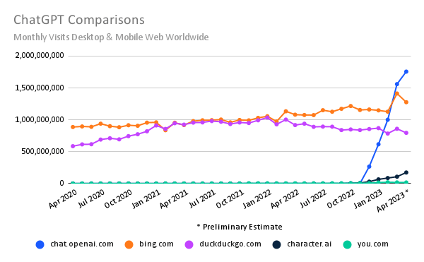
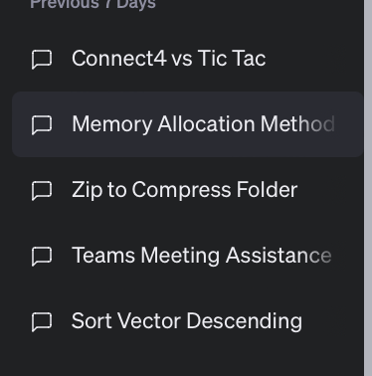
Scalable web apps are everywhere: AI era
Essentially, also a web APP
Pre-AI era: request handling = order an item
AI era: request handling = use model to do an inference
The same system requirements
High request rate
Massive data: both for training & for serving history data
New requirements
Huge computation power required
According to GPT (☺), an inference of GPT ~= sorting 100,000,000 numbers
Per-user sessions

Slide 4
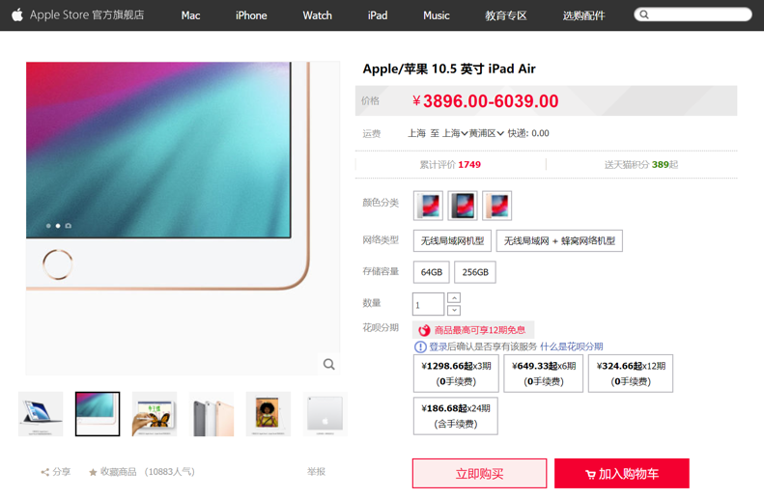
Case study: An e-commerce web application
Notes:
2003 年马云 创建淘宝

Slide 5

Each click needs thousands of servers to cooperate
Caching server
Caching server
…
Caching server
Caching
Caching
Caching
Distributed caching
Database server
Database server
CDN
Users
Application #1
generate the page
Database
user, price
…
Database
user, price
Application server
Distributed database
Internet
Load
Balance
Application #2
add the order
File server
File server
File server
File:
image
File:
image
…
File:
image
Application server
…
…
Message queue
Distributed file system

Slide 6
How to build Taobao on a single machine (in old days)?
Operating system:
Linux (in OS class)
Serving the requests: web server
Apache, Nginx (in ICS)
Serving the data: file system & DB
MySQL & inode file system (in CSE)
Displaying the page: HTML
PHP (in Web class)
LAMP = Linux + Apache + MySQL + PHP

Slide 7

Using one server to build Taobao
https://www.taobao.com
Internet
Application
generate the web page
File:
image
Database:
user, price
Server

Slide 8
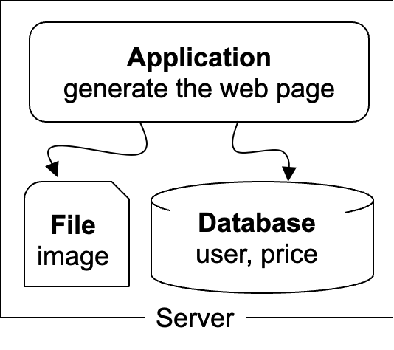
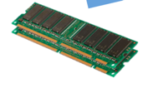
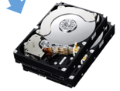
The architecture of LAMP cannot scale!
https://www.taobao.com
Internet
The disk & memory of one server cannot store massive amount of data
DRAM: 64 – 256 GB
HDD: 2 – 40 TB
Facebook has more than 1 billion of images uploaded weekly, Baidu stores tens of billions of web pages
File:
image
Database:
user, price
DRAM
HDD

Slide 9
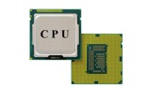
The architecture of LAMP cannot scale!
https://www.taobao.com
Internet
Application uses the CPU for processing, while a single CPU can hardly scale due to the end of Moore’s law & Dennard scaling
Moore’s law: the number of transistors in a dense integrated circuit (IC) doubles about every two years.
Dennard scaling: as transistors get smaller, their power density stays constant
Application
generate the web page
Notes:
摩尔定律：元器件上的元器件翻倍
Dennard： 尺寸缩小，能耗降低

Slide 10

Step #1 for scalability: disaggregating application & data
Scale
Application: handles application logic
Can be scaled with more CPUs
Database: requires reading/writing disk & cache
Can be scaled with faster disks & larger memory
File system: store large bulks of data
E.g., images, videos
Can be scaled with faster disks
Application
generate the web page
Application server
Local area network
File server
Database server
Scale
Scale
File:
image
Database
user, price
Database
user, price

Slide 11
Step #2 Avoid the slow data accesses? Caching
Observation: most requests access a small portion of the data (locality)
Caching system with a single node:
E.g., page cache
Drawbacks: limited DRAM capacity
Distributed caching server
Benefits: huge DRAM capacity, e.g., deploy many caching servers
Application
generate the web page
Application server
Local area network
Caching server
Caching server
Caching
Caching
File server
Database server
File:
image
Database
user, price

Slide 12
Case study of distributed cache server: Memcached
Distributed caching server
Benefits: huge DRAM capacity
Memcached server
Store all the cached data in memory
Can scale out to use multiple servers
Memcached clients
Check whether server has cached data
On cache miss, fallback to database/file
Question:
How to find which server has cached the data?
Application
generate the web page
Net
Comm
Memached API
S0: 10.0.0.100
S1: 10.0.0.101
Routing
Application server
Local area network
Caching server#0:
10.0.0.100
Caching server#1:
10.0.0.101
Caching
Memached
Caching
Memached

Slide 13
Case study of distributed cache server: Memcached
Naïve method, hashing:
address = Hash(key) % #server
Problem:
What if we add a new server?
Suppose that we add server from 3→4
Then there would be ~50% miss!
Solution: consistent hashing
Suppose that we add server from 3→4
It will only incur < 25% miss
More details in later lectures
How to find the data?
Consistent hashing

Slide 14
Step #3 for scalability: more app servers
Internet
For stateless application servers
E.g., web servers
We can add more servers for scaling its performance
What is stateless?
The server only executes the logic that only relies on input data but no long-term state
Benefits:
Better fault-tolerance
Better elasticity
Application
generate the web page
Application
generate the web page
Application
generate the web page
Application server #N
Application server #N
Application server #N
Local area network
Caching server
Caching server
Caching
Caching
File server
Database server
File:
image
Database
user, price

Slide 15
Step #3 for scalability: How to do the load balance?
Load balance: how to route the user quests to the application servers?
Leverage the network layer
HTTP redirection,
reverse proxy,
…
Load balance algorithms
round-robin,
random,
hashing,
…
Internet
Load balancer
Application
generate the web page
Application
generate the web page
Application
generate the web page
Application server #N
Application server #N
Application server #N

Slide 16
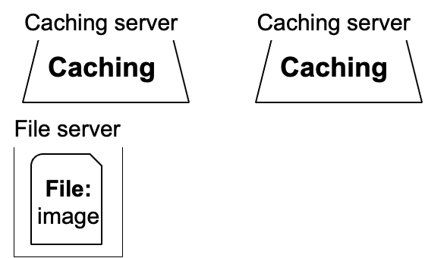
Step #4 for scalability: scaling database
#1. Separate the database for read/write
E.g., use primary-backup replication
The primary servers the writes and backup only serves reads
#2. Separate a table on multiple databases
e.g., a bank has reported that a single table has 100,000,000 rows
However, split a table on multiple machines complex consistency management
Application
generate the web page
Application
generate the web page
Application
generate the web page
Application server #N
Application server #N
Application server #N
Local area network
Write
Read
Database server
Database server
Database
user, price
Database
user, price

Slide 17
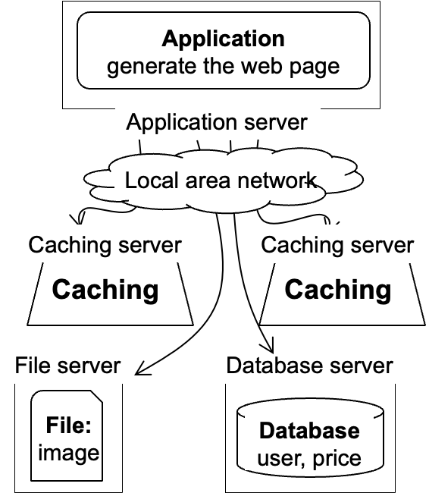
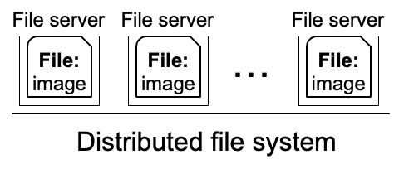
Step #5 for scalability: using distributed file system
Using multiple database in principle makes the database distributed
We can use a similar approach to make the file system distributed !
Well-known distributed file system
NFS (Network file system)
GFS (Google file system)
HDFS
Ceph
Etc.
Application
generate the web page
Application server
Local area network

Slide 18
Step #6 for scalability: using CDN
Goal: return the results to user as soon as possible
Why? Amazon has reported that 100ms latency increase will cause 1% financial loss
Core idea: caching (again)
E.g., CDN (content delivery network) caches the content at the network providers, which is closer to users
Challenge: how to do it without users’ awareness?
CDN
Users
Application
generate the web page
Internet
Application server
…
Notes:
Example: jquery

Slide 19


Step #7 for scalability: separate different applications
Use dedicated servers for different applications
How to run different servers on top of the same hardware?
Containers w/ K8S
Application #1
Alipay
Internet
Application server
Application #2
Taobao
Application server

Slide 20


How to handle complex requests?
Example: after the website becoming larger, handling requests is far more than displaying a (static) web page
Alipay (支付宝)
E.g., fraud detection
Taobao
Hot list (热榜)
Dynamic product ads (千人千面)
Recommendation (you might also like)
…
Hot lists
Customized ads

Slide 21
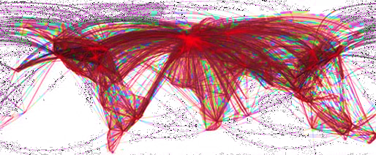

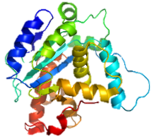
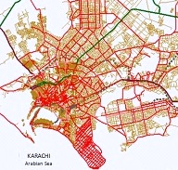
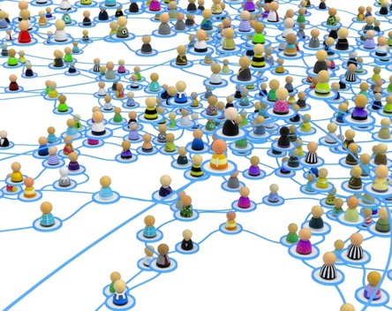


Use distributed computing frameworks for complex queries
General batch processing systems
MapReduce, Spark, etc.
Graph processing systems
GraphLab, Pregel, etc.
Machine learning systems
Tensorflow, pytorch, etc.

Slide 22
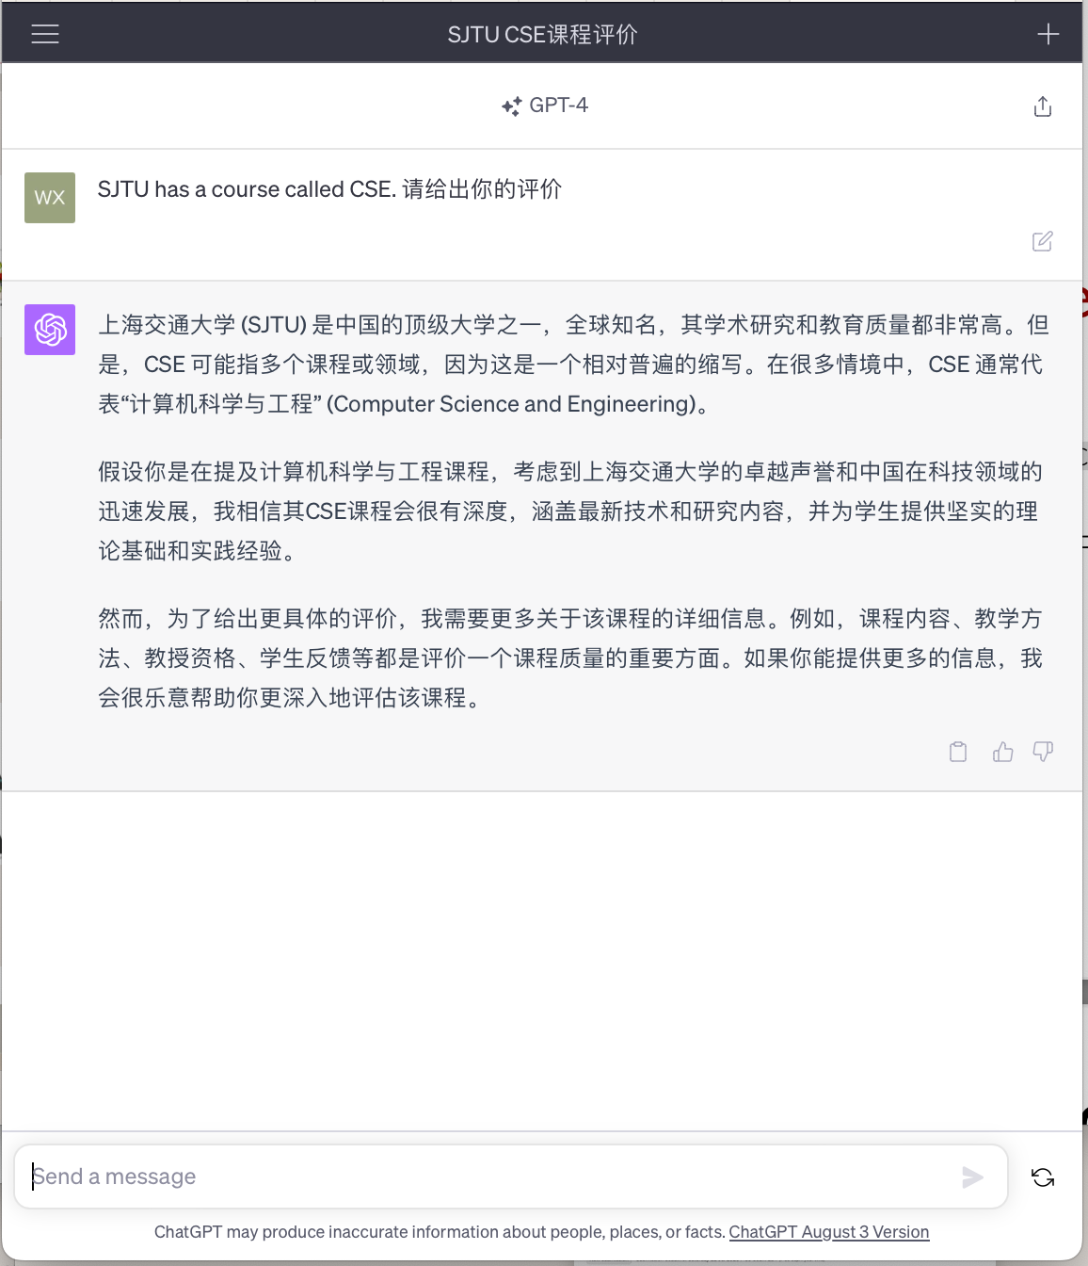
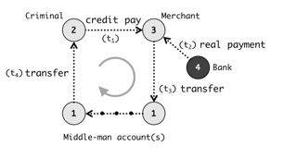

Step #7: separated applications + distributed computing
Example (Each system is backed by multiple machines)
Use general batch processing system to generate hot list
Use graph system to detect credit card fraud
ML framework
e.g., Pytorch, Deepspeed
Application #3
Chatbot
Application server
Application #1
Alipay
Graph processing
e.g., GraphLab
Internet
Application server
Generate hot lists
Application #2
Taobao
Batch processing
e.g., MapReduce
Application server

Slide 23
Different storage systems to support different services
Scalable Database
Scalable file system
Scalable
Key-value store

Slide 24
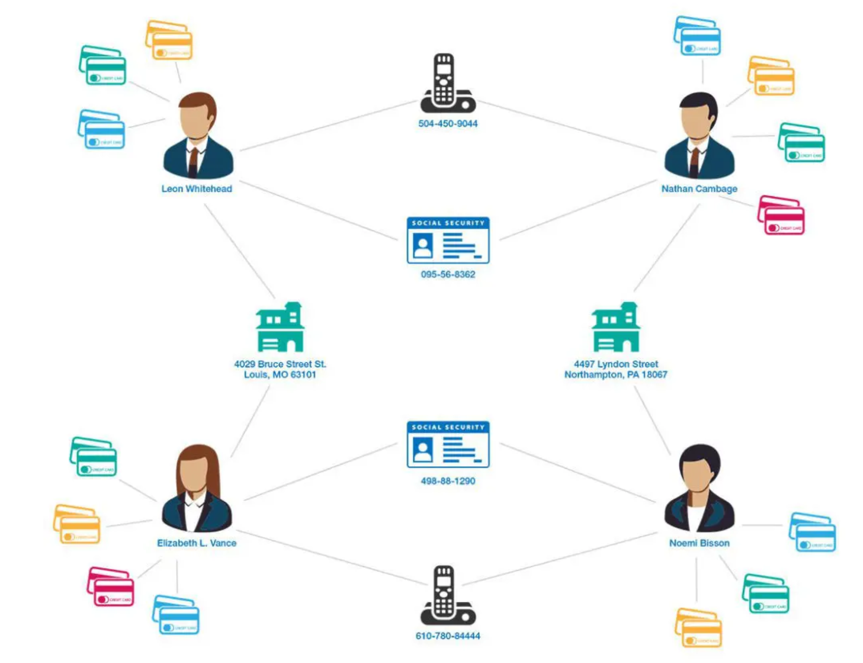
Computation frameworks to support different services
Hot topics
Fraud detection
Chat Bot
Scalable graph processing system
Source: https://www.graphable.ai/blog/graph-database-fraud-detection/
Scalable batch processing system
Scalable ML/AI systems

Slide 25
A scalable website: overall picture
We have not covered all the parts
E.g., how to manage containers?
Yet most of them are orthogonal to the scalability concepts in this class
Caching server
Caching server
Caching server
…
Caching
Caching
Caching
Distributed caching
Database server
Database server
CDN
Users
Application #1
generate the page
Database
user, price
…
Database
user, price
Application server
Distributed database
Internet
Load
Balance
Application #2
add the order
File server
File server
File server
File:
image
File:
image
…
File:
image
Application server
…
…
Message queue
Distributed file system

Slide 26
Recall: we have talked about distributed system
But what is a distributed system?

Slide 27
A scalable website: powered by distributed systems!
Distributed system: A distributed system is a collection of independent computers that appears to its users as a single coherent system.
- DISTRIBUTED SYSTEMS Principles & Paradigms, Second Edition
Caching server
Caching server
Caching server
…
Caching
Caching
Caching
Distributed caching
Database server
Database server
CDN
Users
Application #1
generate the page
Database
user, price
…
Database
user, price
Application server
Distributed database
Internet
Load
Balance
Application #2
add the order
File server
File server
File server
File:
image
File:
image
…
File:
image
Application server
…
…
Message queue
Distributed file system

Slide 28
Modern scalable system systems are
large & distributed
Powered by large-scale datacenter

Slide 29
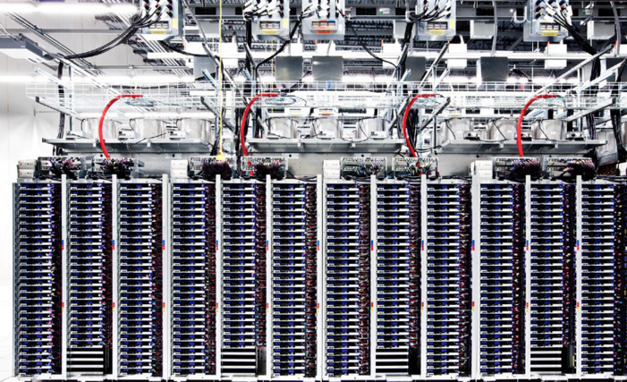
Scalable websites are powered by modern datacenters
Large server and storage farms
CPUs: > 20,000,000 cores
Disk capacity: > 1,000,000 GB
10-100 MW of power
Caching server
Caching server
…
Caching server
Caching
Caching
Caching
Distributed caching
Database server
Database server
CDN
Users
Application #1
generate the page
Database
user, price
…
Database
user, price
Application server
Distributed database
Internet
Load
Balance
Application #2
add the order
File server
File server
File server
File:
image
File:
image
…
File:
image
Application server
…
…
Distributed file system

Slide 30
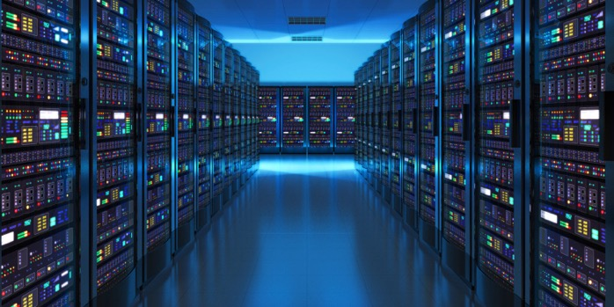
Datacenters that power the scalable website
Large-scale distributed systems: 10K – 100K servers
Each rack: 40 servers
Complex networking for connecting servers
To cooperate, we must communicate
Source: “The Datacenter as a Computer --- An Introduction to the Design of Warehouse-Scale Machines”

Slide 31
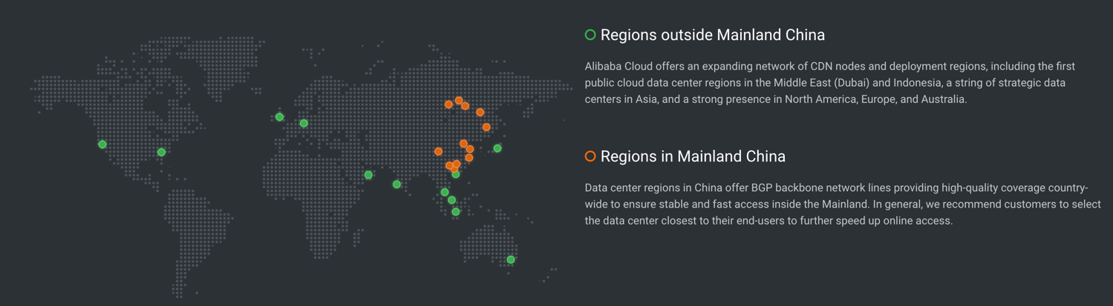
Datacenters are geo-replicated
The locations of Alibaba datacenters
Source: https://www.alibabacloud.com/zh/global-locations

Slide 32
Design large-scale distributed system is challenging
Fault is common, how to handle it?

Slide 33
Fault is common: fault, error, failure
Fault can be latent or active
if active, get wrong data or control signals
Error is the results of active fault
e.g. violation of assertion or invariant of spec
discovery of errors is ad hoc (formal specification?)
Failure happens if an error is not detected and masked
not producing the intended result at an interface
Notes:
SDC：乘法加速器比较容易出bug

Slide 34
Fault is common
, especially in large distributed systems
Why faults are common especially in distributed systems? Scale!
“Suppose a cluster has ultra-reliable server nodes with a stellar mean time between failures (MTBF) of 30 years (10,000 days)—a cluster of 10,000 servers will see an average of one server failure per day. ”
Source: The Datacenter as a Computer
-- An Introduction to the Design of Warehouse-Scale Machines

Slide 35
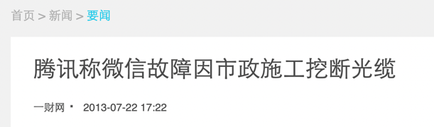

Fault is common
especially in large distributed systems
What are the causes?
Why faults are common especially in distributed systems? Scale!
“Suppose a cluster has ultra-reliable server nodes with a stellar mean time between failures (MTBF) of 30 years (10,000 days)—a cluster of 10,000 servers will see an average of one server failure per day. ”
Causes:
Operation error (human, configuration, etc.)
Software error (e.g., bug)
Hardware error
Power outage
Natural disaster
Source: The Datacenter as a Computer
-- An Introduction to the Design of Warehouse-Scale Machines

Slide 36
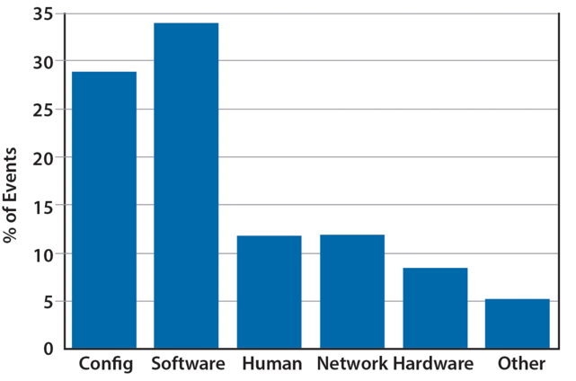
Fault is common
especially in large distributed systems
What are the causes?
Why faults are common especially in distributed systems? Scale!
“Suppose a cluster has ultra-reliable server nodes with a stellar mean time between failures (MTBF) of 30 years (10,000 days)—a cluster of 10,000 servers will see an average of one server failure per day. ”
Causes:
Operation error (human, configuration, etc.)
Software error (e.g., bug)
Hardware error
Power outage
Natural disaster
Source: The Datacenter as a Computer
-- An Introduction to the Design of Warehouse-Scale Machines

Slide 37
Faults and partial failures
On a single computer, it either works or it doesn’t
But in a distributed system, some parts of the system can be broken in some unpredictable way
Such failure is partial (aka., grey failure)
Since most other parts of the system are OK, we want the system still working!

Slide 38

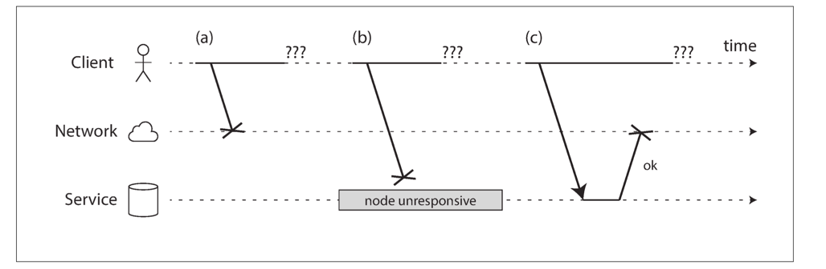
Faults and partial failures
Example: unreliable network
A client (e.g., Smartphone), sends requests to the service (e.g., Taobao), through network (5G, Wifi)
The client gets: “网络竟然奔溃了”, how can a network break?
Notes:
Challenge: how to detect the faults?

Slide 39
Example: unreliable network
A user sends a request but the server does not reply, possible reasons:
1. The remote node may have failed (e.g., it crashed or it was powered down).
2. The request may have been lost (e.g., someone unplugged a network cable).
3. The request may be waiting in a queue and will be delivered later (e.g., the network or the recipient is overloaded).

Slide 40

Example: unreliable network
A user sends a request but the server does not reply, possible reasons:
4. The remote node may have temporarily stopped responding (e.g., it is experiencing a long garbage collection pause)
5. The remote node may have processed your request, but the response has been lost on the network (e.g., a network switch has been misconfigured).
6. The remote node may have processed your request, but the response has been delayed and will be delivered later (e.g., the network or your own machine is overloaded).

Slide 41
Another common fault: network partition
A network partition refers to network decomposition into relatively independent subnets
Can happen when a switch is being upgraded in a datacenter
Can even happen when being attacked by sharks
Network partition is usually a reality
You can never count on the network connectivity

Slide 42
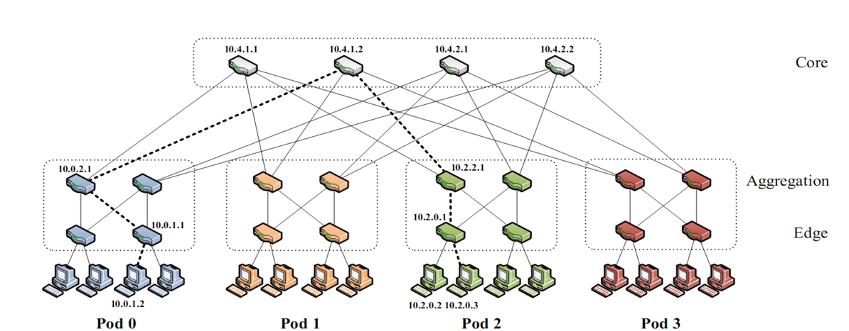
Another common fault: network partition
A network partition refers to network decomposition into relatively independent subnets
Can happen when a switch is being upgraded in a datacenter
For example, suppose the datacenter adopts a fat-tree topology
Source: https://www.cs.cornell.edu/courses/cs5413/2017sp/lectures/16-datacenter-topologies2.pdf

Slide 43
Another common fault: network partition
A network partition refers to network decomposition into relatively independent subnets
Can happen when a switch is being upgraded in a datacenter
For example, suppose the datacenter adopts a fat-tree topology
Source: https://www.cs.cornell.edu/courses/cs5413/2017sp/lectures/16-datacenter-topologies2.pdf

Slide 44
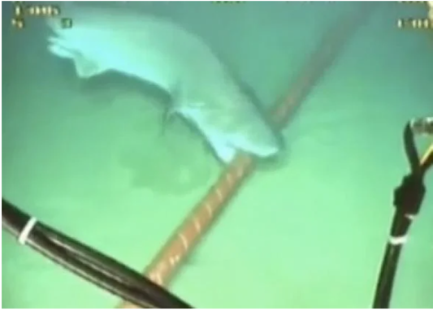
Another common fault: network partition
A network partition refers to network decomposition into relatively independent subnets
Can happen when a switch is being upgraded in a datacenter
Can even happen when being attacked by sharks
Source: https://slate.com/technology/2014/08/shark-attacks-threaten-google-s-undersea-internet-cables-video.html

Slide 45
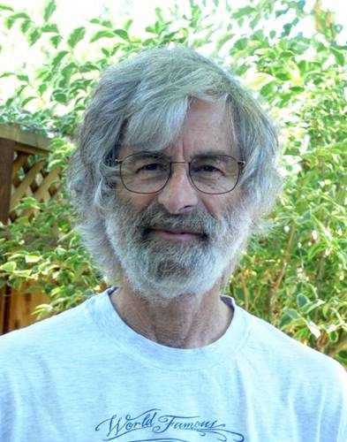
You know you have a distributed system when the crash of a computer you’ve never heard of stops you from getting any work done.
- Leslie Lamport
Lamport received the 2013 Turing Award for "fundamental contributions to the theory and practice of distributed and concurrent systems, notably the invention of concepts such as causality and logical clocks, safety and liveness, replicated state machines, and sequential consistency" in 2014.

Slide 46
Distributed system will handle these faults to provide an “always-on” illusion
But it is not an easy task

Slide 47
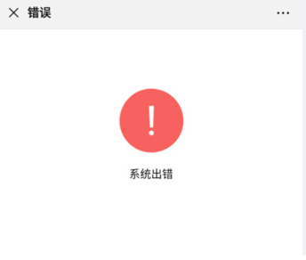
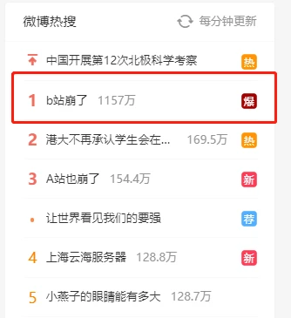




Slide 48
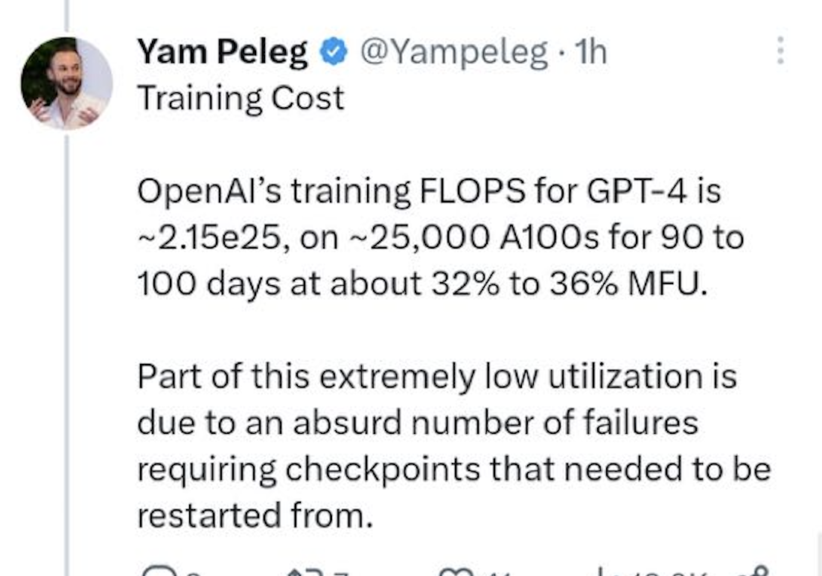
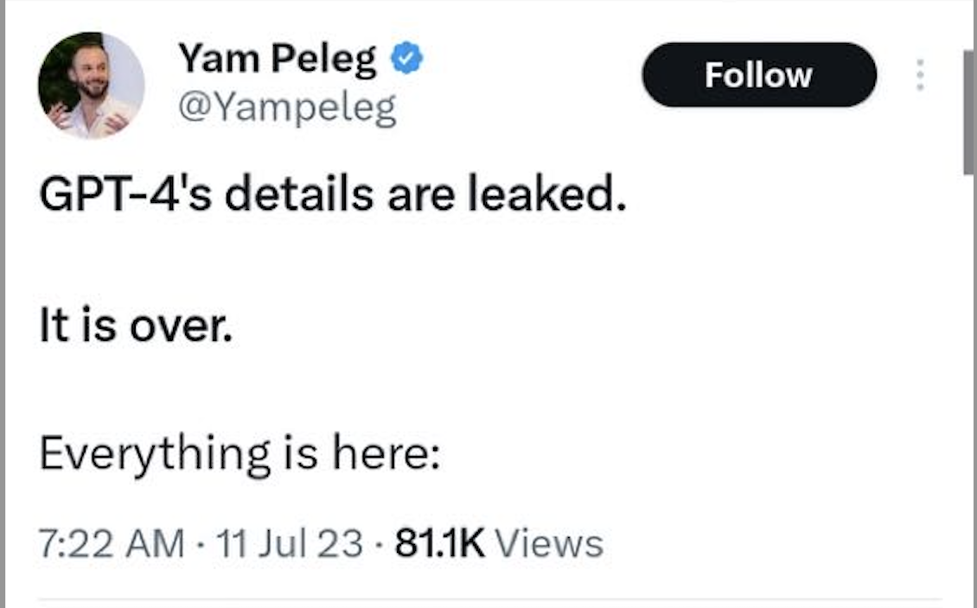

Slide 49
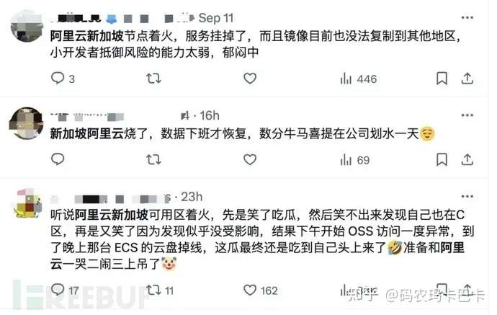
Notes:
今年9月10日，阿里云服务又宕机了。

Slide 50


Availability and reliability
Availability: A measure of the time that a system was usable, as a fraction of the time that it was intended to be usable (x nines), corresponding downtime:
e.g. 3-nines -> 8 hour/year
e.g. 5-nines -> 5 min/year
e.g. 7-nines -> 3 sec/year
Metrics to measure reliability
MTTF: mean time to failure
MTTR: mean time to repair
MTBF: mean time between failure
MTBF = MTTF + MTTR

Slide 51





Large-scale systems can be highly available
Case#1: Internet, the BGP (Border Gateway Protocol) is highly available
Case#2: WeChat, Taobao & Baidu rarely (but not never) become outage
Case #3: OpenAI successfully trained GPT despite many failures ☺

Slide 52
Achieving high availability: handling failures w/ replications
Replication
replicas: identical multiple copies
Example: replicated file servers
If one copy survives, the application is available
Application
generate the web page
Application server
Local area network
File server
File server
File server
File:
image
File:
image
File:
image
Identical copies

Slide 53
Challenge: consistency
Replication
replicas: identical multiple copies
Example: replicated file servers
If one copy survives, the application is available
Challenge: consistency
Application
generate the web page
Application server
Local area network
File server
File server
File server
File:
image
File:
image
File:
image

Slide 54
Challenge: consistency
Replication
replicas: identical multiple copies
Example: replicated file servers
If one copy survives, the application is available
Challenge: consistency
Application put file A to one server
Application
generate the web page
Application server
1
Local area network
File server
File server
File server
File:
image
File:
image
File:
image

Slide 55
Challenge: consistency
Replication
replicas: identical multiple copies
Example: replicated file servers
If one copy survives, the application is available
Challenge: consistency
Application put file A to one server
The server crashed
Application
generate the web page
Application server
Local area network
2
File server
File server
File server
File:
image
File:
image
File:
image

Slide 56
Challenge: consistency
Replication
replicas: identical multiple copies
Example: replicated file servers
If one copy survives, the application is available
Application put file A to one server
The server crashed
What happens when read A again?
Application
generate the web page
Application server
Local area network
3
File server
File server
File server
File:
image
File:
image
File:
image

Slide 57

Achieving high availability: handling failures
Replication
replicas: identical multiple copies
Techniques to cope ensure consistency under replication:
Primary-backup replication
Replicated state machine
…

Slide 58
Achieving high availability: handling failures via retry
Restart or reconstruct
Monitoring and catching errors
Restart or reconstruct the system (sub-system)
E.g., restart the stateless application server is ok
What about consistency? Must made trade-off
Stateless applications does not have consistency issue
Some applications, like Google search, can even tolerate occasional inconsistency
Can you notice the inconsistency of search results?
Question: can LLM serving be tolerated via retries?

Slide 59
The CAP theorem
Consistency, Availability & Partition tolerance

Slide 60
CAP: an example
Amazon has two zones: US and Euro
All US users connect to the US zone
All Euro users connect to the Euro zone
Define Availability and Consistency
C: all users see the actual number of items
Not-C: users see 1 item left, but actually is 0
A: all users can buy items at any time (if there are some)
Not-A: users might get "cannot buy now, please wait and retry”
P: the system can get A & C even the only link between US and Euro is broken
Not-P: otherwise

Slide 61
The CAP theorem: 2 out of 3
It is impossible for a distributed computer system to simultaneously provide all three of the following guarantees
Consistency (all nodes see the same data at the same time)
Availability (a guarantee that every request receives a response about whether it succeeded or failed)
Partition tolerance (the system continues to operate despite arbitrary message loss or failure of part of the system)
v₀
v₀
v₀
v₀
v₁
v₀
v₁
v₀
v₁
v₀
S₁
S₂
S₁
S₂
S₁
S₂
S₁
S₂
S₁
S₂
S₁
S₂
A=v₁
done
A=?
1. A=v₀
C
C
C
C
C
C
2. Not available

Slide 62


Partition Tolerance
"P" is usually a reality
You can never count on the network connectivity
AP: sacrifice C
If you have one book but sell it to two customers
Maybe just an apology and a small gift coupon
CP: sacrifice A
If you are selling train ticket but cannot deliver
Customer may sue you
But the user can fail to buy the ticket, e.g., 12306 during spring festival in the last few years

Slide 63
CAP: not a Binary Decision
Example: a CP system does not mean no "A" at all during network partition
If the Euro zone and US zone are disconnected, the US zone can still keep available
Only the Euro zone is not available
When the network connects again, apply US zone data to Euro zone for consistency
Notes:
一种情况可以恢复，

Slide 64
Summary of the (ideal) properties of distributed systems
Can our system handle a larger workload?
Scalability
How easy the developer
can use our system?
How fast is our system?
Ease of programming
/Usability
Performance (In terms of throughput & latency)
Consistency
Fault tolerance
Is our data/computation
correct?
What if some component crash?

Slide 65
Other properties are also important
Correctness
Performance Isolation
Utilization
Energy Efficiency
Compatibility
Security
Privacy
Trust

Slide 66
Summary of the (ideal) properties of distributed systems
Sharding
Replication
Load balancing
New hardware
Scalability
Ease of programming
Performance
DSM, RPC, MapReduce, …
Caching, Accelerators, …
Consistency
Fault tolerance
Sequential, eventual,
consensus, isolation, etc.
High availability: replication & checkpointing
Durability: atomicity, logging, etc.

Slide 67
Summary of the (ideal) properties of distributed systems
These properties typically cannot achieve at the same time
The adults want them all, but the reality forces them to make trade-offs
Remote Procedure Call (RPC)
Distributed Shared Memory (DSM)
Scalability
Scalability
Ease of
programming
Performance
Ease of
programming
Performance
Consistency
Fault tolerance
Consistency
Fault tolerance
NoSQL databases
NewSQL databases (e.g., Spanner)
Scalability
Scalability
Ease of
programming
Performance
Ease of
programming
Performance
Consistency
Fault tolerance
Consistency
Fault tolerance

